Slide 1

MSc Welcome Talk
Dr Chiu Fan Lee
Director of Postgraduate Studies (Taught)
2019/20 Academic Year

Slide 2
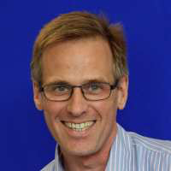
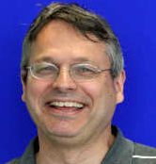
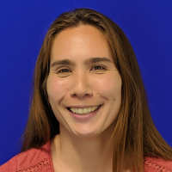
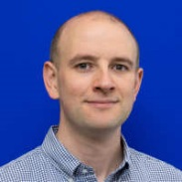
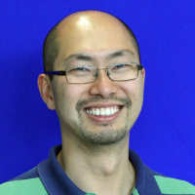
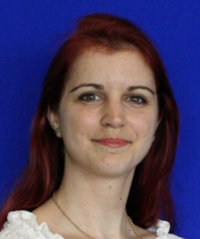
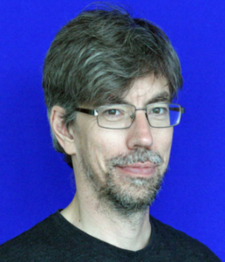
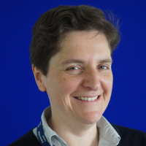
Who We Are
Prof. Anthony Bull
Head of Department
a.bull@imperial.ac.uk
Prof. Etienne Burdet
MSc Human & Biological Robotics Programme Director
e.burdet@imperial.ac.uk
Ms. Sandra Roscoe
Student Wellbeing Adviser
s.roscoe@imperial.ac.uk
Prof. Tom Ellis
Postgraduate Tutor
t.ellis@imperial.ac.uk
Dr Chiu Fan Lee
MSc Biomedical Engineering Programme Director
c.lee@imperial.ac.uk
Ms. Edit Toth
ICT +
Computer Support
e.toth@imperial.ac.uk
Mr. Martin Holloway
Academic Tutor
m.holloway@imperial.ac.uk
Ms. Louise O’Sullivan
Head of Student Programmes

Slide 3
Brief History of Bioengineering at Imperial
Started in 1991 with 10 students
Became a true Department in 2001
Now growing fast:
  50+ Academic staff
  50+ Professional Services Staff
  450+ Undergraduates
  300+ Postgraduates

Slide 4
Who are you?

Slide 5
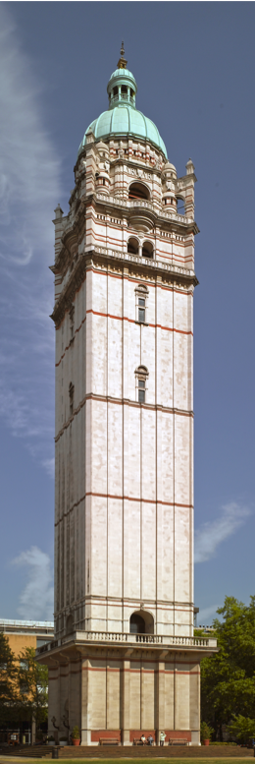
Getting Around …
RSM = Royal School of Mines
RSM (9,10,12)
Queens’ Tower
Sherfield (21)
Bessemer (11)
Shops
Library (25)

Slide 6
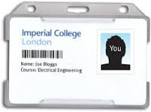

Swipe Card
Keep your SWIPE CARD with you at all times!
It is your IDENTITY to College.
Linked to your student CID.
Contains unique barcode, magnetic strip and RFID chip.
Your swipe card gives you access to:
  All buildings in Bioengineering
  Photocopiers
  The library
  Ethos
  and more …
NEVER lend out your swipe card!

Slide 7
Getting your Swipe Card
  You must register before you can get your card.
    If not registered, then you need to do this now (eService)
    http://www3.imperial.ac.uk/registry/currentstudents/howtoregister.
    You need to upload a photo (quicker to get your card).
  If you already registered but don’t have your card:
    Come to the registration session TODAY at 3pm in RSM 3.03
    If it is not there, check in the Student Office (RSM 3.21c) daily thereafter
  ID Card Office (Sherfield 151) can re-issue lost cards (£10 fee)
More Information see:
https://www.imperial.ac.uk/students/new-students/undergraduates/arrivals-and-induction/collecting-your-college-id/

Slide 8
College Hours
Normal Working Hours: 8:30am – 5:30pm
Must vacate building by 11:30pm (security comes around!)
No lone working in laboratories without staff presence and/or approved lone working risk assessment

Slide 9
Points of Interest
Lecture Rooms
RSM 301c (Class/Seminar Room)
RSM 303 (Bagrit Seminar Room)
RSM G01, G05, G08, G20, G38, G39, 131, 228, 338
  Student Office
  RSM 3.21c
Bioengineering Common Room
RSM 3.06

Slide 10
Computers
Large computer room for student use:
RSM 338
RSM G08 (100+ desks for all Faculty of Engineering students).
Further PCs in the Library and RSM 3.06.
Own laptops OK, but must be registered with ICT
College-wide login and password issued by ICT.
email: should go live within 2-3 days.
You MUST observe the computing rules.

Slide 11

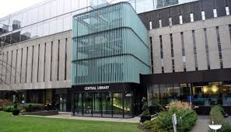
Library
Main Central Library is on west side of campus near Queen’s lawn/ Tower.
Other libraries at the hospital campuses.
Extensive electronic resources.
Small Bioengineering collection in the Department – see Mr Martin Holloway in 3.08 to borrow items.

Slide 12
Local Knowledge
Lockers are on lower ground floor of RSM
Students bring their own locks and label the locker according to instructions
More lockers are on RSM Level 4: daily use only
Vending machines in Bessemer lobby & Sherfield Building.
Food and drink: Level 3 RSM; College Café (Business School); Electrical Engineering Café (Dalby Court); Junior Common Room, Fusion, H-Bar

Slide 13
Local Knowledge
Mail: Pigeon holes outside Student Common Room.
Telephones: No outside or personal calls. Internal phones in computer rooms and labs.
Photocopying:
Copying/printing access via your SWIPE card
Initial allowance: £100, purchase further credit at the
Library
Copiers are available in the Library
Colour printers in RSM 338 and Level 4 RSM.

Slide 14
How to Address Staff in the Department
In the UK, is customary to use titles in an academic setting. This includes all manner of communication (especially emails and questions in and out of class!)
Staff with a PhD or MD are referred to as Doctor/Dr or Professor/Prof
Staff without a PhD/MD are referred to as “Mr” or “Ms”
Although you may enter a first-name relationship with a staff member, never assume and always use the appropriate title. If unclear, check the Departmental website!

Slide 15
MSc Biomedical Engineering

Slide 16
Biomedical Engineering - Streams
The MSc course consists of 4 streams:
Biomaterials and Tissue Engineering
Biomechanics and Mechanobiology
Medical Physics and Imaging
Neurotechnology
The Curriculum consists of 3 assessed elements:
Core courses (compulsory, common to all streams) [27.6%]
Specialist courses (stream specific modules which you must take, and one elective to be chosen from a given selection) [27.6%]
Individual Research Project [44.4%]
Additional Requirements:
Departmental Seminars
Plagiarism Awareness Course

Slide 17
Biomedical Engineering – Compulsory core (27.6%)
BE9-MBIMG Principles of Biomedical Imaging
BE9-MJCLUB Journal Club
BE9-MMDC Medical Device Certification
BE9-MSPHYS Systems Physiology
BE9-MSTDA Statistics and Data Analysis

Slide 18
Biomechanics and Mechanobiology stream (27.6%)
Core modules:
Biomechanics
Molecular Cellular and Tissue Biomechanics
Orthopaedic Biomechanics
Optional modules (chose two)
Biomedical Advanced Computational and Stress Analysis
Cellular and Molecular Mechanotransduction
Human Neuromechanical Control and Learning
Tissue Engineering and Regenerative Medicine
Biomimetics

Slide 19
Biomaterials and Tissue Engineering stream (27.6%)
Core modules:
MSE315 Biomaterials for Bioengineering
MSE417 Advanced Biomaterials
MSE418 Advanced Tissue Engineering
BE3-HTERM Tissue Engineering and Regenerative Medicine
Elective modules (choose one):
BE9-MBMX Biomechanics
BE9-MBMIME Biomimetics
BE9-MMTI Molecular and Tissue Imaging (subject to satisfactory progress in BE9-MBIMG Principles of Biomedical Imaging)
BE3-MMB Mathematical Methods for Bioengineers

Slide 20
Medical Physics stream (27.6%)
Core modules:
BE9-MAPMDA Advanced Physiological Monitoring and Data Analysis
BE3-HIPR Image Processing
BE9-MMTI Non-ionising Functional and Tissue Imaging
BE9-MFIMG Ionising Tissue & Flow Imaging
Elective modules (choose one):
BE9-MMB Mathematical Methods for Bioengineers
BE9-MINS Neuroscience
BE9-MECT Engineering in Cancer Therapy

Slide 21
Neurotechnology stream (27.6%)
Core modules:
BE9-MBMI Brain Machine Interfaces
BE9-MMB Mathematical Methods for Bioengineers
BE9-MINS Neuroscience
Elective modules (choose two):
BE9-MCNS Computational Neuroscience*
BE9-MBBB Bits, Brains and Behaviours*
BE9-MHNCL Human Neuromechanical Control and Learning
BE9-MHASP Hearing and Speech Processing
BE9-MBMIME Biomimetics
* = capped module. Where oversubscribed, places are normally allocated by random ballot

Slide 22
MSc Human and Biological Robotics

Slide 23
HBR – Compulsory core (27.6%)
Systems Physiology
Statistics and Data Analysis
Medical Device Entrepreneurship
Robotics 1
Human Neuromechanical Control and Learning

Slide 24
HBR – Electives (27.6%)
Students are permitted to choose five modules, to include at least four modules from elective group (A)
Group A
BE9-MHASP Hearing and Speech Processing
BE9-MBMIME Biomimetics
BE9-MCNS Computational Neuroscience*
BE9-MBBB Bits, Brains and Behaviours*
BE9-MBMX Biomechanics
BE9-MBMI Brain Machine Interfaces*
EE462 Selected Topics in Computer vision*
Group B
BE9-MALBIR Animal Locomotion and Bioinspired Robots*
BE3-HHCARD Human Centred Assistive and Rehabilitation Devices*
ME3-HECM Embedded C for Microcontrollers*
CO333 Robotics*
* = capped module. Where oversubscribed, places are normally allocated by random ballot

Slide 25
Meeting with Programme Director
Meeting with Prof Burdet after this session at 12pm!
  Room: RSM 3.03

Slide 26
Both programmes

Slide 27
Choosing your elective module(s)
Please choose your elective module(s) by this Friday 4th 5pm on DSS (www.imperial.ac.uk/dss)
Some modules are capped due to room capacity
  E.g., Machine Learning and Neural Computation
    Note- very strong Maths skills needed for this course!
  For capped courses, your choice will not be confirmed until next week
  If a module is over-subscribed, for those for which it is not compulsory, a random selection will be made
  If you do not get a place on your preferred elective module, you will be prompted to make another choice

Slide 28
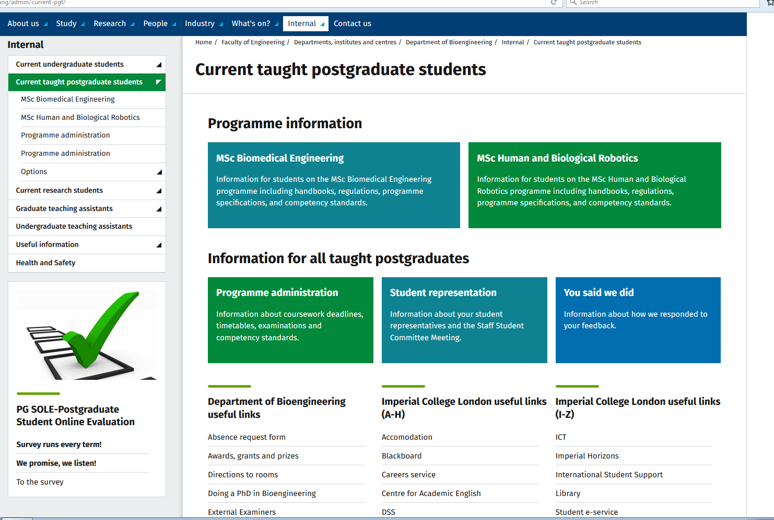
Timetable
Lectures typically held Monday – Friday between 09:00 – 18:00
Wednesday afternoon - no lectures/ reserved for sport
Lectures start:
Monday 7 October, 2019
Lectures:
Focus on core concepts.
Normally start at xx:00, end xx:50
Study groups:
Focus on applications
Office Hours/Feedback Sessions:
scheduled individually by instructors
may want to email in advance
underutilised chance to get feedback
Be punctual!!
Most up-to-date timetables available on the Bioengineering website

Slide 29
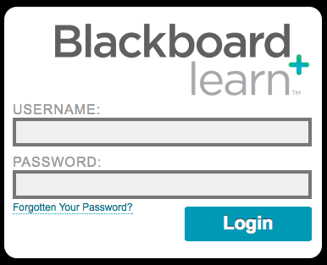
Course Materials
All course materials are posted on Blackboard:
Lecture slides
Handouts
Tutorials
Past exam papers.
https://bb.imperial.ac.uk
Blackboard also contains:
Coursework/ report submissions via Turnitin (automatic plagiarism detection)
Marks record/ grade book
Module correspondence.

Slide 30
Time Line
Autumn Term (30 September – 13 December, 2019)
Week 1 30 Sept - 4 October No teaching
Weeks 2-6 7 October - 8 November Teaching
Week 7 11 -15 November Reading Week
Weeks 8-11 18 November -13 December Teaching

Slide 31
Reading Week
You are expected to remain present and assessable during Reading Week.
Reminder: UK Border Agency and College Regulations require enrolled students to be present during term-time. Absences are not allowed unless they are necessary and authorised beforehand. Requests can be made with an absence form (supervisor and MSc Director need to approve)
There will be no lectures in Reading Week, so you can catch up with learning and also work on coursework/ projects.
GTA-led laboratories and Journal Clubs will run in Reading Week so you can continue to get GTA support. Attendance at these labs and Journal Clubs is still mandatory
The Reading Weeks apply to Bioengineering courses ONLY. If you take courses at other departments (E.g., Biomaterials) you will very likely have lectures during our Reading Week. Although some departments also have a reading week, it might not be the same week as ours.

Slide 32
Time Line
Spring Term (04 January – 20 March 2020)
Week 1 6 – 10 January Exams Part 1
Weeks 2-6 13 January - 14 February Teaching
Week 7 17 – 21 February Reading Week
Weeks 8-11 24 February – 20 March Teaching
Summer Term (25 April – 26 June 2020)
Revision Classes (to be scheduled, but not all lecturers offer revision before exam)
Exams part 2 (to be scheduled).
Research Time: From end of exams to mid-September
Course ends in mid-September when you submit the MSc Thesis
You MUST be present over the summer!

Slide 33
Assessment and Results
Coursework/Reports:
We have coursework calendars online so you can see when your work is due and when feedback will be provided:
http://www.imperial.ac.uk/bioengineering/admin/current-pgt/programme-administration/
Exams:
Marks will NOT be released until after the Exam Board Meeting (mid-October)**
Feedback will NOT be provided.
**Preliminary exam marks may be released in March (for January exams) and August (for Summer exams), but these grades are subject to change by the Exam Board.
When do I hear my results?
Pass list will be released in late October
Detailed marks available from Registry in November
Re-sits are taken at the next available opportunity (January/ May).
What if I need my results for a job/ PhD application?
It is impossible to release the marks prior to the Exam Board
Typically, a letter from the Student Office to explain this will suffice.

Slide 34
UK Marks
> 90% Almost unheard of
> 70% A - Excellent
60-70% B - Very good
50-60% C - Good/pass
40-50% D - Fail
< 40% Fail
You must obtain > 50% in each module and the your aggregate imust be > 50%.
If you obtain < 50% you may have to resit the module.

Slide 35
Exams Timing
January Exams:
  Statistics and Data Analysis
  Systems Physiology
  Biomechanics
  Robotics 1
  Medical device entrepreneurship
  Neuroscience
Summer Exams:
  Everything else!

Slide 36
Plagiarism Awareness
Plagiarism is an academic offence and penalties are severe
Assignments submitted electronically are automatically scanned for plagiarism.
From the College Policy on Plagiarism:
Plagiarism, which is the presentation of another person's thoughts , words or images and diagrams as though they were your own ... You are encouraged to read and criticise the work of others as much as possible, and you are expected to incorporate this into your thinking and in your coursework and assessments. But you must be sure to acknowledge and identify your sources.
All MSc students must complete a compulsory plagiarism awareness course by the end of Autumn term:
http://www.imperial.ac.uk/study/pg/graduate-school/professional-skills/masters/plagiarism-online/

Slide 37
Research Project (44.4%)
Project list will be released in November
Project allocation in December
Project work starts in Term 2
Term 2: part-time
Term 3: full-time after exams.
There will be a lecture by the Projects Coordinator in November to kick-start the process.

Slide 38
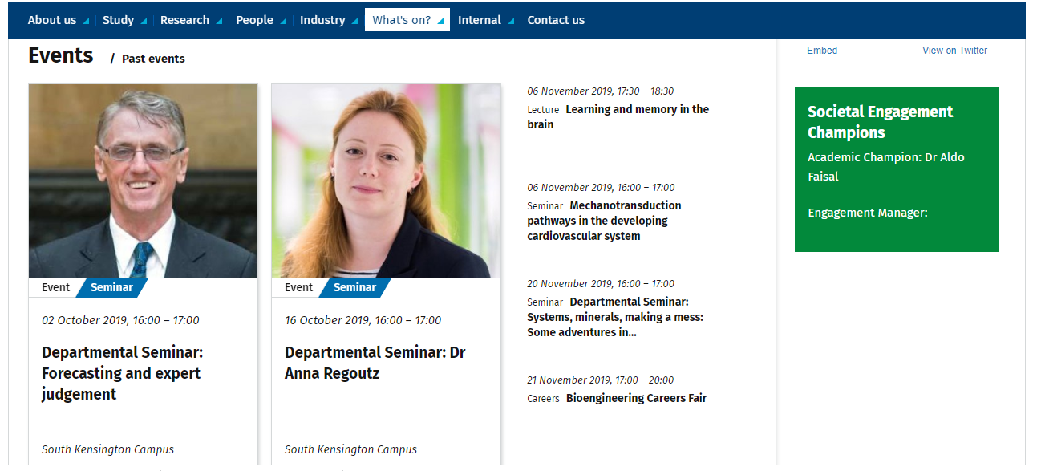
Departmental Seminars
Your chance to see presentations by world leaders in Bioengineering from across the globe
Keep an eye on the Department’s News/Events page:
http://www.imperial.ac.uk/bioengineering/whats-on/

Slide 39
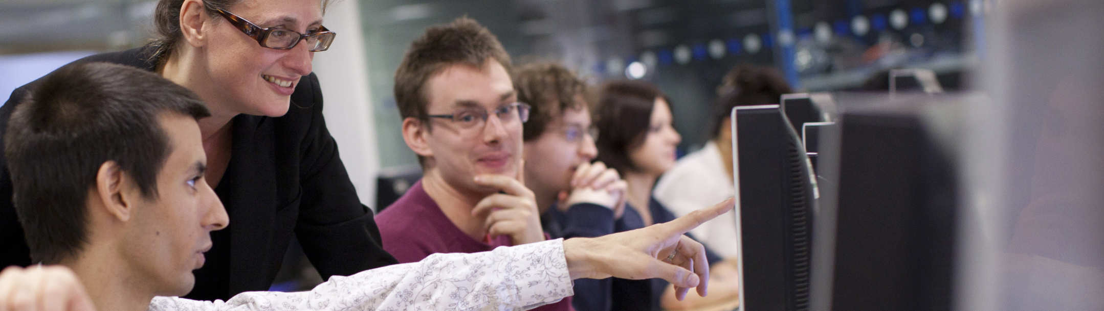
Feedback
Feedback comes in many forms:
Oral (questions during lectures, discussions with Instructors after lectures etc.)
Personal (discussion with Instructors during office hours)
Interactive (problem solving tutorials with GTAs, study groups etc.)
Written (solutions/model answers to courseworks)

Slide 40
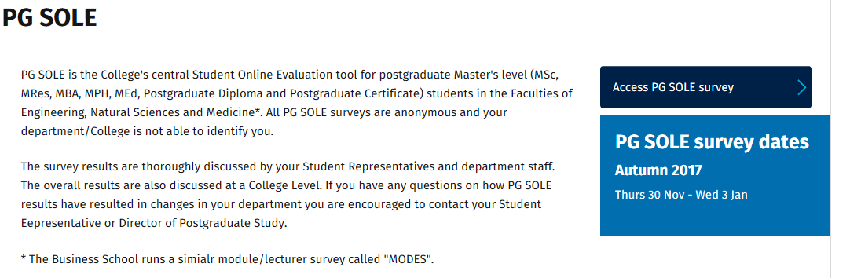
Student Surveys
PG SOLE (Postgraduate Student Online Evaluation)
Internal to College
Completed for each course once per term
Directly impacts the content and delivery of our MSc
PTES (Postgraduate Taught Experience Survey)
External to College
National Survey to rank postgraduate taught degree programmes
Spring 2020 is next PTES

Slide 41
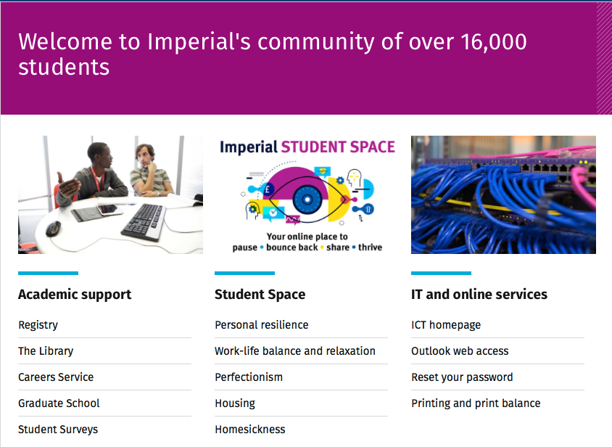
Professional Development
Embedded Throughout Course:
Clear and effective communication, written and oral
Problem solving/ analytical skills
Project planning
Innovation and creativity
Research skills
Independent learning
Career planning.

Slide 42

Student advice and support services
http://www.imperial.ac.uk/helpme or click on ‘Students’ on Homepage
Academic appeals and regulations
Careers Advisory Service
Chaplaincy
College Hardship/Access to Learning Funds
College Tutors
Director of Student Affairs
Disability Advisory Service
English language support
Equality
Health Centre
ICU Advice Centre
ICU student representation
International student support
Maths support (METRIC)
NHS Dentist
PG success guide
Student Counselling Service
Wardens
Student Hub Level 3, Sherfield Building provides wide range of information and advice: Monday to Friday

Slide 43
If you need help
Course matters:
Graduate Teaching Assistants
Student Office
Student Representatives
Course Leader
Personal Tutor, Academic Tutor and myself
Other (pastoral) matters:
Your Personal Tutor
Academic Tutor
Postgraduate Tutor
Faculty Tutors
Projects:
Project supervisor
Student reps
Project co-ordinator (Dr Masouros)
Academic Tutor (Mr Holloway)
myself

Slide 44
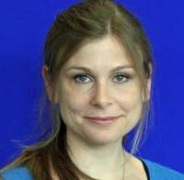

Student Representation
Formal Route
Informal Route
Talk to your Personal Tutor
Talk to the MSc Director
Talk to Academic or Senior Tutor
Talk to Nicole or Louise
Staff-Student Committee Meeting
Stream Representative
Student with a comment
Dr Claire Higgins Senior Tutor
Mr. Martin Holloway Academic Tutor
Comments can be anonymous
Comments are recorded in SSCM minutes
Raised actions will be addressed
Tends to be slow (1 meeting per term)
Discussions can be confidential (just ask)
No formal record of discussion
Someone will help you!
Tends to be fast

Slide 45
Sickness and Absence
If you fall ill, or need to be absent, you must tell the Student Office (RSM 3.21c) bg-studentoffice@imperial.ac.uk as soon as possible.
Telephone 020 759 45122. The phone number is also in your MSc handbook.
The Student Health Centre is in Princes Gardens (see campus map).
College provides extensive counselling services and help, in case you need them.

Slide 46
Elect your Student Representative
One student for each stream in the MSc Biomedical Engineering programme
One student for the MSc Human and Biological Robotics programme
Serves as a point of contact between students and staff
Representative will sit on the Staff/Student Committee Meeting each term
Selection occurs during first meeting of Journal Club.
Questions? Please contact
Prof Etienne Burdet (e.burdet@imperial.ac.uk) or
Myself Dr Chiu Fan Lee (c.lee@imperial.ac.uk)

