Slide 1
TOAST
The Original Academic Staff Time survey
June 2021

Slide 2
Purpose of Presentation
Background to TOAST
Who will be involved
Involvement of surveyed staff
How is the survey completed
Survey tool - Qualtrics
Support
College use of information

Slide 3
Background to TOAST
TOAST is used to allocate academic staff costs, which is required to complete the annual OfS and UKRI return, TRAC (Transparent Approach to Costing)
This return provides a useful tool to understand the extent to which the core activities of Teaching and Research are sustainable financially
The TRAC return also calculates the indirect and estates rates that are used on research proposals
Data was last collected in 2017-18 TOAST survey
All universities required to re-survey to confirm allocation at least every 3 years

Slide 4
Who will be involved?
Academic staff in all departments/divisions –
  Lecturers
  Senior Lecturers
  Readers
  Professors
Academic champions communicate the importance of the survey to colleagues
Honorary staff are excluded

Slide 5
Involvement of surveyed staff
Each academic to complete 3 diary returns for 3 non-adjacent weeks
Weeks randomly selected – 2 term-time or 1non-term time
All weeks are during 2021-22 academic year
In each survey week, academic staff are asked to account for activities by entering values in a matrix table
Balance between detail, time, effort and usefulness
Provost and Heads of Department will be provided details of staff being surveyed before their week and non-respondents before the close of the survey week

Slide 6
How is the survey completed
Notification email that your survey week is upcoming
Email containing link to survey will be sent on first day of survey week
Record activities for each day, Monday to Sunday, entering the total number of hours for each activity you have undertaken each day. There are five main categories:
  Teaching
  Research
  Professional Activities
  General Support
  Non College-Related Activities
Within each category, you can enter the number of hours spent on each specific activity
All values entered must total 24 for each day of your survey week
Each value can be a whole number or .5 to represent half hours

Slide 7
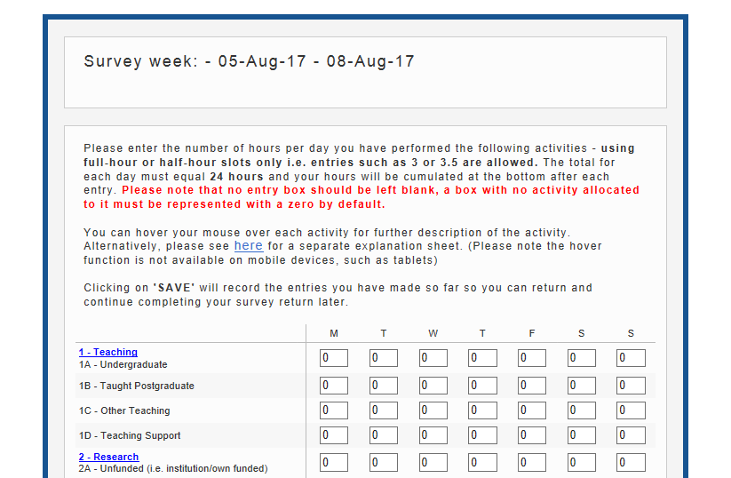
Survey Tool – Qualtrics

Slide 8
How the process is supported
On-line guidance on how to complete the survey
FAQs and instructions on how to allocate your time to the listed activities
Email address for queries: TOAST@imperial.ac.uk
Website for further information: www.imperial.ac.uk/TOAST

Slide 9
How the College uses the information
We, as all universities, report to OfS and UKRI the costs of teaching, research and other activities, split into public and non-publically funded activities
  TOAST informs the College allocation of academic staff costs
Aspects of the time allocations will impact upon the indirect rate used on research proposals, although the return should be an accurate reflection of how time is spent across all activity categories
Your returns are anonymous, results will not be used for performance management
Government only accepts if the data is statistically robust, therefore, it is critical that all academics participate
A high response rate is vital (as near to 100% as possible)

Slide 10
Thank you
Contact – TOAST@imperial.ac.uk

